Slide 1



Title: How to revise
Make a list of things you could do to revise.
Challenge: Which of these activities would be the most effective for revision? Why?

Slide 2

Learning Objectives
LO1: To describe the different types of learners
LO2: To identify different types of activities
LO3: To practise a revision sequence
How to revise

Slide 3
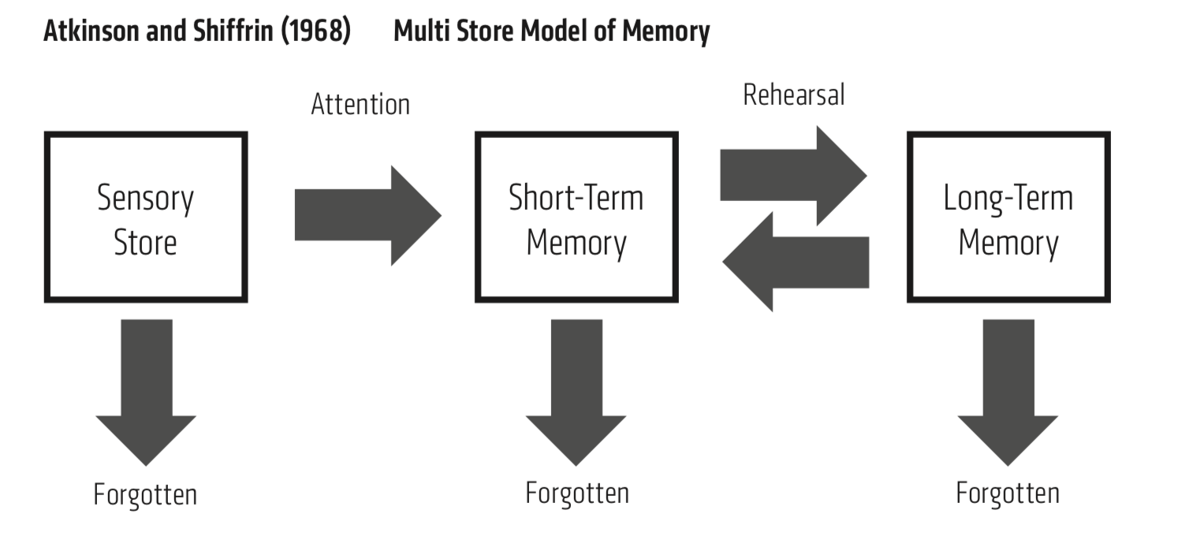
Why do we revise?

Slide 4

Why do we revise?
At the end of a lesson, the things you have learnt are in your-short term memory.
You have to keep ‘retrieving’ this information and using it, otherwise it will disappear. Thinking hard about something is what pushes it from short-term to long-term.
In an exam, you only have your long-term memory.

Slide 5
Using metacognition to help us revise
Metacognition
You need to understand how to learn something as well as what to learn
Metacognition helps you to revise effectively at home, when you don’t have teachers to help you or tell you what to do.
Independent revision is the key to being successful in assessments or exams.
Golden rule of memory:
If it isn’t difficult, it isn’t working

Slide 6
4 types of learners
Level 1: You don’t really understand how to revise and so don’t know where to start.
Level 2: You know what activities you like to complete (e.g. mindmaps) but you’re not sure why, and you often stick to topics you are comfortable with.
⭐Level 3: You can plan a revision strategy based on what you need to revise but you struggle to change that strategy if something’s not working.
Y11:
⭐⭐Level 4: You can identify what you need to revise. You know when you have learnt enough to move on, when you need to go back a step, or change the activity.
Challenge: Add a sentence to your summary sheet explaining which type of learning you think you are and which you want to be. Make sure you say why.

Slide 7




Metacognition:
learning how to revise as well as what to revise
Metacognition:
learning how to revise as well as what to revise
There are 4 types of learners. I am a Level ……….. learner because …
I will aim to be a Level ………........ learner by Year 11.
There are 4 types of learners. I am a Level ……….. learner because …
I will aim to be a Level ………........ learner by Year 11.
Level 1: Don’t know where to start with revision | Level 2: Know what revision you like to do, but not sure why | Level 3: Can pick revision activities yourself | Level 4: Can see what is or isn’t working and change
Level 1: Don’t know where to start with revision | Level 2: Know what revision you like to do, but not sure why | Level 3: Can pick revision activities yourself | Level 4: Can see what is or isn’t working and change
You do this by understanding what activities are for and how they can help you make progress.
Types of activities
You do this by understanding what activities are for and how they can help you make progress.
Types of activities
Step 1: Retrieval practice: Go over what you to know to see what you need to revise. E.g. Quiz
Step 1: Retrieval practice: Go over what you to know to see what you need to revise. E.g. Quiz
Step 2: Facts: Learn the key information.
E.g. mindmap, short notes
Step 2: Facts: Learn the key information.
E.g. mindmap, short notes
Step 3: Explanation: Explain why the information matters for the question you’re answering.
E.g. summaries, essay plans
Step 3: Explanation: Explain why the information matters for the question you’re answering.
E.g. summaries, essay plans
Step 4: Assess/evaluate: Have your strategies worked? E.g. mini quiz or evaluation sheet
Step 4: Assess/evaluate: Have your strategies worked? E.g. mini quiz or evaluation sheet

Slide 8
Types of activities
When teachers plan lessons, each activity is designed to focus on specific skills.
Each skill should be practiced separately, so that it is easier to do them all at the same time in an exam.
Retrieval practice
Go over what you to know to see what you need to revise
E.g. Quiz
Facts
Learn the key information
E.g. mindmap
Explanation
Explain why the information matters for the question you’re answering.
E.g. summaries
Assess/evaluate
Have your strategies worked?
E.g. mini quiz or evaluation sheet

Slide 9
Step 1: What do I revise?
The first step of revising successfully is to identify your strengths and weaknesses.
What do you need to improve/focus on?
Retrieval practice:
You should test your memory. What would you be able to remember in an exam?
If you struggle with remembering certain topics, you know that you need to start your revision there.
Revision activity 1:
Complete the quiz without using your book.

Slide 10
Retrieval practice quiz:
Retrieval practice quiz:
Retrieval practice quiz:
Retrieval practice quiz:

Slide 11
Progress Check
Retrieval practice quiz:
1 -
Answer
The topic I need to revise is …..

Slide 12
Step 2: How do I revise it?
Use the information sheet to make a mindmap on the topic you got wrong.
Include:
✓ dates
✓ names
✓ key events
✓ causes
✓ consequences
Challenge: You need to actively learn these. Read a fact outloud, cover it up, see if you can remember. Repeat the process with another fact, but test yourself on both.
Golden Rule - it has to be hard work!
Remember that recalling facts after a period of time is more effective revision than recalling it straight away.

Slide 13
Step 2:A - assess
Assess how well you know this material.
Summary of the topic
Write a summary of your topic using the key details you need to know.
Check it with your notes. Did you include everything?
Task 2: If the answer is yes, give it a tick and move onto Step 3. If you missed something, use a different colour to add the extra information.

Slide 14
Step 3: Evaluation
You need to be able to use these facts to answer a question.
Pick an exam question based on the topic you are revising.
Bullet point your exam answer.
Include:
✓ dates
✓ names
✓ key events
Challenge: Try to complete the plan without using your notes. When you’ve done that, add missing notes/explanation in a different colour
Golden Rule - it has to be hard work!
Remember that recalling facts after a period of time is more effective revision than recalling it straight away.

Slide 15

Step 3A: assess
Evaluate how successful your revision was
Does anything need to change?
 | Yes | No
Did you complete this work to the best of your ability?
Did you make an effort to think about the facts you were writing down, and try to remember them?
Would you feel confident answering a question on this in an assessment?
Do you think you would have made more progress if the activities were different? If yes, please give details of the activity and what you might replace it with.
In the next revision session I will ….

Slide 16
What could I change for next time?
What could I change for next time?
 | Yes | No
Did you complete this work to the best of your ability?
Did you make an effort to think about the facts you were writing down, and try to remember them?
Would you feel confident answering a question on this in an assessment?
Do you think you would have made more progress if the activities were different? If yes, please give details of the activity and what you might replace it with.
My revision was ꗃ successful ꗃ not successful
In the next revision session I will ….
 | Yes | No
Did you complete this work to the best of your ability?
Did you make an effort to think about the facts you were writing down, and try to remember them?
Would you feel confident answering a question on this in an assessment?
Do you think you would have made more progress if the activities were different? If yes, please give details of the activity and what you might replace it with.
My revision was ꗃ successful ꗃ not successful
In the next revision session I will ….

Slide 17
Booklet option

Slide 18
What could I change for next time?
Metacognition:
learning how to revise as well as what to revise
 | Yes | No
Did you complete this work to the best of your ability?
Did you make an effort to think about the facts you were writing down, and try to remember them?
Would you feel confident answering a question on this in an assessment?
Do you think you would have made more progress if the activities were different? If yes, please give details of the activity and what you might replace it with.
My revision was ꗃ successful ꗃ not successful
In the next revision session I will ….
There are 4 types of learners. I am a Level ……….. learner because …
I will aim to be a Level ………........ learner by Year 11.
Level 1: Don’t know where to start with revision | Level 2: Know what revision you like to do, but not sure why | Level 3: Can pick revision activities yourself | Level 4: Can see what is or isn’t working and change
You do this by understanding what activities are for and how they can help you make progress.
Types of activities
Step 1: Retrieval practice: Go over what you to know to see what you need to revise. E.g. Quiz
Step 2: Facts: Learn the key information.
E.g. mindmap, short notes
Step 3: Explanation: Explain why the information matters for the question you’re answering.
E.g. summaries, essay plans
Step 4: Assess/evaluate: Have your strategies worked? E.g. mini quiz or evaluation sheet

Slide 19
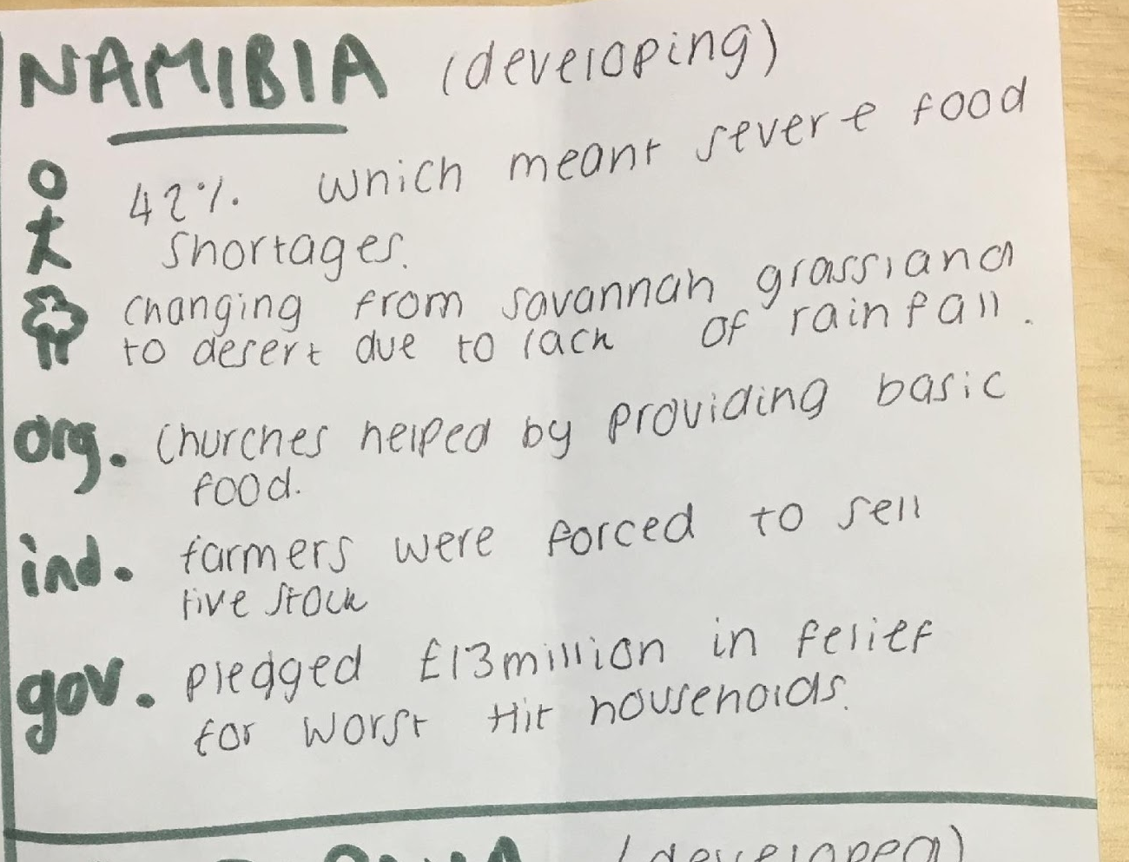
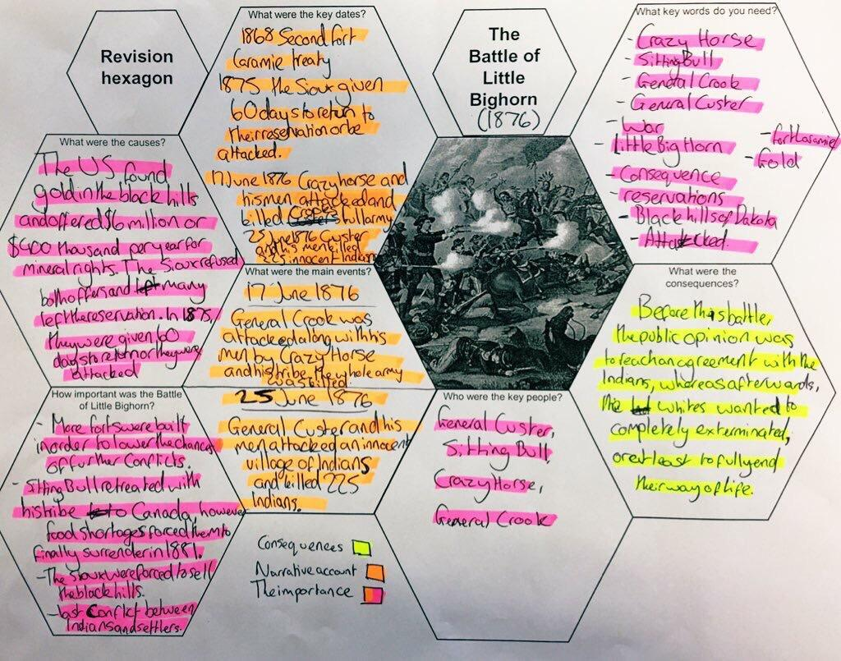
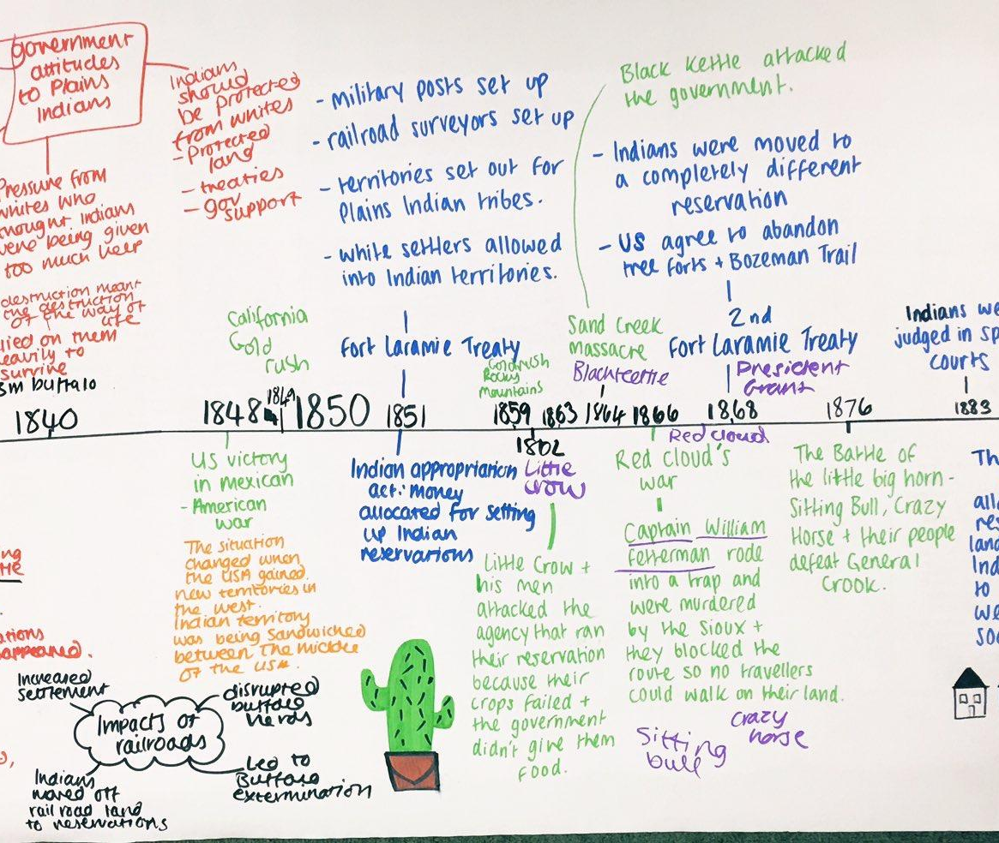
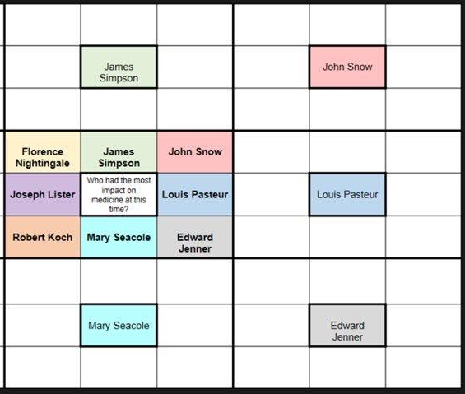
Retrieval practice
Facts
Explanation
Assess
Activity examples
Activity Ideas
Dual coding | Hexagon
Timeline | Lotus diagram - make notes around the key topic
Mini quiz
Use your notes to make a quiz. You could use GCSE pod, Seneca Learning, or BBC Bitesize too.
RAG rating
Get a topic list and rate each part of it - red if you don’t remember anything; amber for some, green for all. Work on red topics first.
Tell me 5
List five facts you know about each topic (could be in a grid or mindmap). If you can’t list 5, revise it.
Dual coding
Summarise notes with
simple stick-men diagrams from memory and then with notes.
Mindmap/Flashcard/
timeline
Summarise a whole topic or section using categories and colour to organise the information.
Lotus diagrams/
hexagons
Use structured diagrams to summarise topics or areas of a topic.
Revision recipes
Teachers use a series of activities that focus on different skills. Each activity (ingredient) builds on the skills of the last, so that by the end of the lesson all the skills can be used together – the recipe has been put together. In each revision session, work through the groups of activities and pick one ‘ingredient’ from each.
Read a minute, bullet a
minute
Then check how much you remembered!
Revision guide
questions
Answer the Grade 1-4, 5-6, 7-8 questions in the knowledge booklets on topics you struggle with.
Basic: Retrieval Facts Assess Assess topic
Quiz Mindmap Summarise reflect
Exam questions
Write/plan an answer from memory, and then in a different colour fill in the gaps using the spec, need-to-know list, or revision guide.
Reflection questions
Ask yourself if you did your
best work. If you did, did it work? Is there a quicker or more effective activity you could do next time? What could you change?
Even when you are confident, keep including it in retrieval practise so you don’t forget it.
Standard: Retrieval Facts Assess Explanation Assess
Quiz Flashcards Quiz Factor grid Reflect
Factor grid
List all the factors in that course, e.g. technology/the church for medicine. Bullet point key information beneath, from across the time periods.
Expert: Retrieval Facts Assess Explanation
Tell me 5 Lotus Fill in blanks Essay Add notes
Assess: add notes Assess: reflection on activities

Slide 20
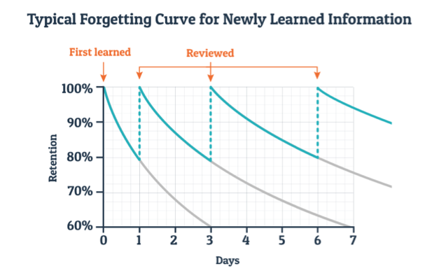
Alternative graph

