Slide 1
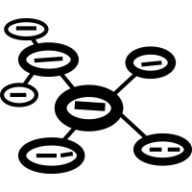


Title: How to revise
Make a list of things you could do to revise.
Challenge: Which of these activities would be the most effective for revision? Why?

Slide 2
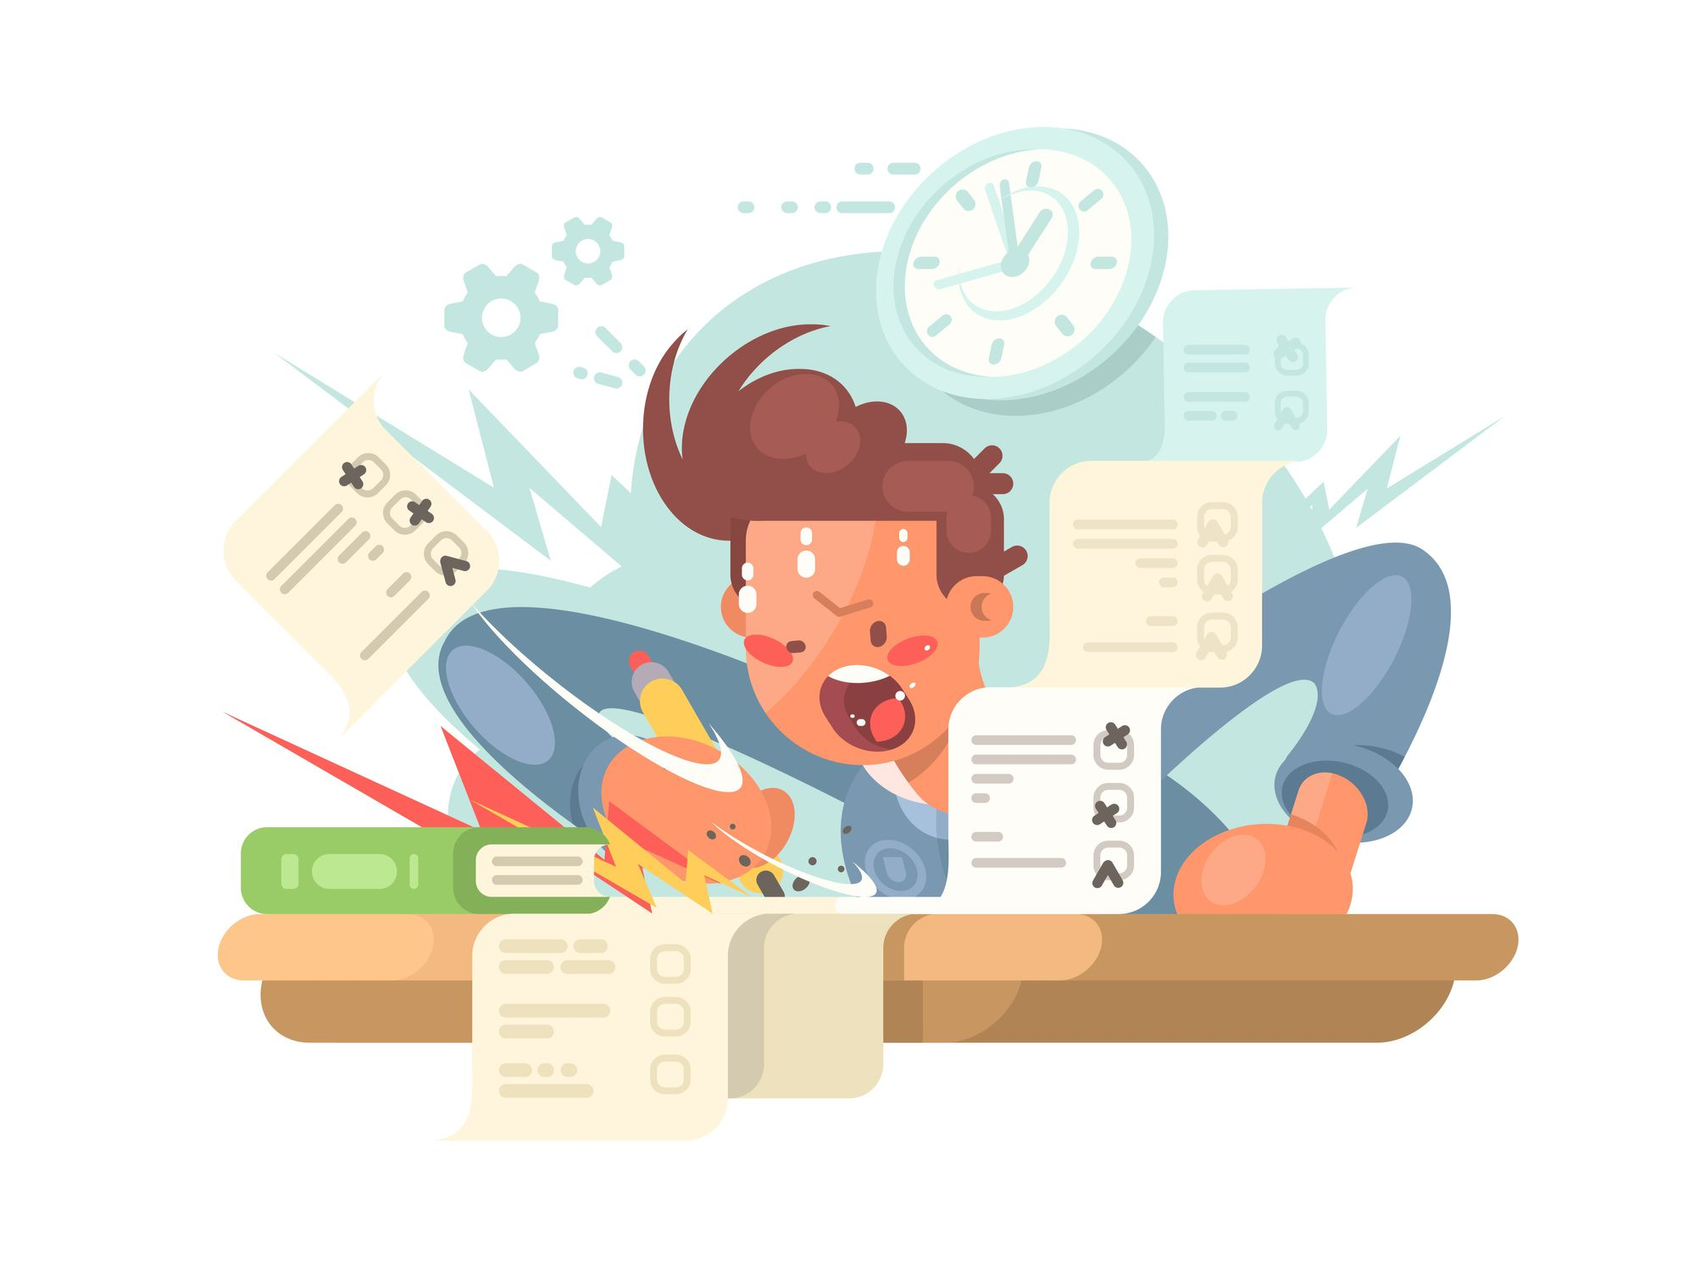
Learning Objectives
LO1: To describe the different types of learners
LO2: To identify different types of activities
LO3: To practise a revision sequence
How to revise

Slide 3
Why do we revise?
revision
working memory
long-term memory
forgotten
used in the exam

Slide 4

Why do we revise?
You have to keep ‘retrieving’ information from your short-term memory or it will fall out.
Thinking hard and often is what pushes information from short-term to long-term memory.
For example, if you want a nail to stay in the wood then you have to hammer it in.
In an exam, you only have your long-term memory.

Slide 5
Using metacognition to help us revise
Metacognition
You need to understand how to learn something as well as what to learn
Metacognition helps you to revise effectively at home, when you don’t have teachers to help you or tell you what to do.
Independent revision is the key to being successful in assessments or exams.
Golden rule of memory:
If it isn’t difficult, it isn’t working

Slide 6
4 types of learners
Level 1: You don’t really understand how to revise and so don’t know where to start.
Level 2: You know what activities you like to complete (e.g. mindmaps) but you’re not sure why, and you often stick to topics you are comfortable with.
⭐Level 3: You can plan a revision strategy based on what you need to revise but you struggle to change that strategy if something’s not working.
Y11:
⭐⭐Level 4: You can identify what you need to revise. You know when you have learnt enough to move on, when you need to go back a step, or change the activity.
Challenge: Add a sentence to your summary sheet explaining which type of learning you think you are and which you want to be. Make sure you say why.

Slide 7




Metacognition:
learning how to revise as well as what to revise
Metacognition:
learning how to revise as well as what to revise
There are 4 types of learners. I am a Level ……….. learner because …
I will aim to be a Level ………........ learner by Year 11.
There are 4 types of learners. I am a Level ……….. learner because …
I will aim to be a Level ………........ learner by Year 11.
Level 1: Don’t know where to start with revision | Level 2: Know what revision you like to do, but not sure why | Level 3: Can pick revision activities yourself | Level 4: Can see what is or isn’t working and change
Level 1: Don’t know where to start with revision | Level 2: Know what revision you like to do, but not sure why | Level 3: Can pick revision activities yourself | Level 4: Can see what is or isn’t working and change
You do this by understanding what activities are for and how they can help you make progress.
Types of activities
You do this by understanding what activities are for and how they can help you make progress.
Types of activities
Step 1: Retrieval practice: Go over what you to know to see what you need to revise. E.g. Quiz
Step 1: Retrieval practice: Go over what you to know to see what you need to revise. E.g. Quiz
Step 2: Facts: Learn the key information.
E.g. mindmap, short notes
Step 2: Facts: Learn the key information.
E.g. mindmap, short notes
Step 3: Explanation: Explain why the information matters for the question you’re answering.
E.g. summaries, essay plans
Step 3: Explanation: Explain why the information matters for the question you’re answering.
E.g. summaries, essay plans
Step 4: Assess/evaluate: Have your strategies worked? E.g. mini quiz or evaluation sheet
Step 4: Assess/evaluate: Have your strategies worked? E.g. mini quiz or evaluation sheet

Slide 8
Types of activities
When teachers plan lessons, each activity is designed to focus on specific skills.
Each skill should be practiced separately, so that it is easier to do them all at the same time in an exam.
Retrieval practice
Go over what you to know to see what you need to revise
E.g. Quiz
Facts
Learn the key information
E.g. mindmap
Explanation
Explain why the information matters for the question you’re answering.
E.g. summaries
Assess/evaluate
Have your strategies worked?
E.g. mini quiz or evaluation sheet

Slide 9
Step 1: What do I revise?
The first step of revising successfully is to identify your strengths and weaknesses.
What do you need to improve/focus on?
Retrieval practice:
You should test your memory. What would you be able to remember in an exam?
If you struggle with remembering certain topics, you know that you need to start your revision there.
Revision activity 1:
Complete the quiz without using your book.

Slide 10
Retrieval practice quiz:
1 - In which year was the Battle of Hastings?
2 - Give one reason why William won the Battle of Hastings
3 - What was Thomas Becket’s job?
4 - When was Henry whipped for Becket’s death?
5 - When was the Black Death?
6 - Name one thing that people believed caused the Black Death
Retrieval practice quiz:
1 - In which year was the Battle of Hastings?
2 - Give one reason why William won the Battle of Hastings
3 - What was Thomas Becket’s job?
4 - When was Henry whipped for Becket’s death?
5 - When was the Black Death?
6 - Name one thing that people believed caused the Black Death
Retrieval practice quiz:
1 - In which year was the Battle of Hastings?
2 - Give one reason why William won the Battle of Hastings
3 - What was Thomas Becket’s job?
4 - When was Henry whipped for Becket’s death?
5 - When was the Black Death?
6 - Name one thing that people believed caused the Black Death
Retrieval practice quiz:
1 - In which year was the Battle of Hastings?
2 - Give one reason why William won the Battle of Hastings
3 - What was Thomas Becket’s job?
4 - When was Henry whipped for Becket’s death?
5 - When was the Black Death?
6 - Name one thing that people believed caused the Black Death

Slide 11
Progress Check
Retrieval practice quiz:
1 - In which year was the Battle of Hastings?
2 - Give one reason why William won the Battle of Hastings
3 - What was Thomas Becket’s job?
4 - When was Henry whipped for Becket’s death?
5 - When was the Black Death?
6 - Name one thing that people believed caused the Black Death
1066
Skilled commander
Archb. Of Canterbury
1174
1348
Miasma
The topic I need to revise is …..

Slide 12
Step 2: How do I revise it?
Use the information sheet to make a mindmap on the topic you got wrong.
Include:
✓ dates
✓ names
✓ key events
✓ causes
✓ consequences
Challenge: You need to actively learn these. Read a fact outloud, cover it up, see if you can remember. Repeat the process with another fact, but test yourself on both.
Golden Rule - it has to be hard work!
Remember that recalling facts after a period of time is more effective revision than recalling it straight away.

Slide 13
Step 3: Have I been successful?
Assess how well you know this material.
Summary of the topic
Write a summary of your topic using the key details you need to know.
Check it with your notes. Did you include everything?
Task 2: If the answer is yes, give it a tick. If you missed something, use a different colour to add the extra information.

Slide 14
Progress Check
Evaluate how successful your revision was
Does anything need to change?
 | Yes | No
Did you complete this work to the best of your ability?
Did you make an effort to think about the facts you were writing down, and try to remember them?
Would you feel confident answering a question on this in an assessment?
Did this revision sequence work for you? If not, what will you change?
In the next revision session I will ….

Slide 15
What will I change for next time?
What will I change for next time?
 | Yes | No
Did I complete this work to the best of my ability?
Did I make an effort to think about the facts I was writing down, and try to remember them?
Am I confident answering a question on this in an assessment?
Did this revision sequence work for me? If not, what will I change?
My revision was ꗃ successful ꗃ not successful
In the next revision session I will ….
 | Yes | No
Did I complete this work to the best of my ability?
Did I make an effort to think about the facts I was writing down, and try to remember them?
Am I confident answering a question on this in an assessment?
Did this revision sequence work for me? If not, what will I change?
My revision was ꗃ successful ꗃ not successful
In the next revision session I will ….

